Slide 1

Week #7,#8
AI Academy®
1
Day 1, 2, 3:
Introduction of OOP
Terminologies of OOP
Classes, Objects, Inheritance, Polymorphism, Data Abstraction, Encapsulation, Destructor
Session, Cookies
Reviews & Feedbacks

Slide 2
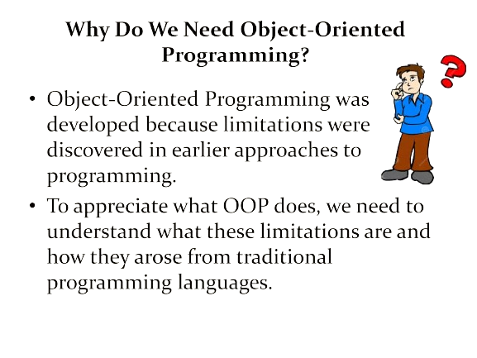
Week #7,#8
AI Academy®
2

Slide 3
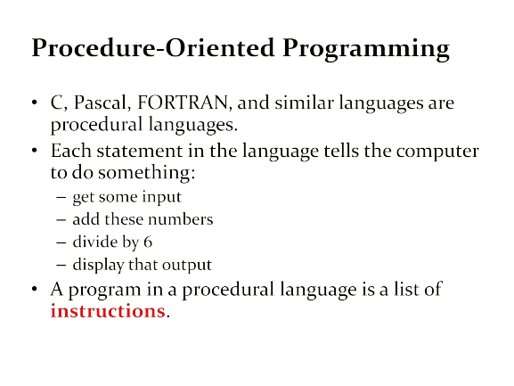
Week #7,#8
AI Academy®
3

Slide 4
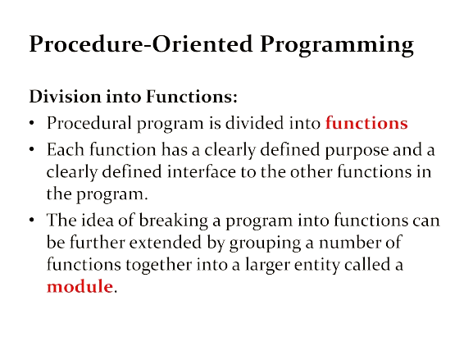
Week #7,#8
AI Academy®
4

Slide 5
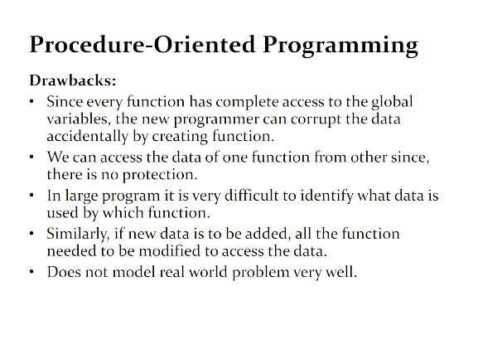
Week #7,#8
AI Academy®
5

Slide 6
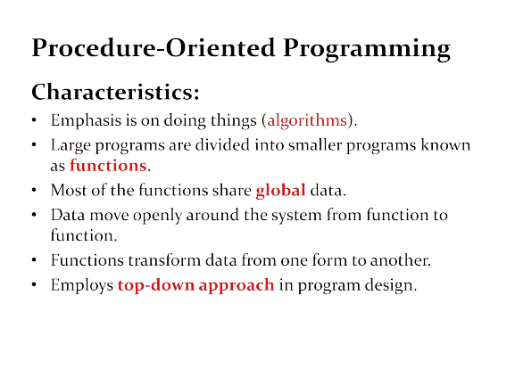
Week #7,#8
AI Academy®
6

Slide 7
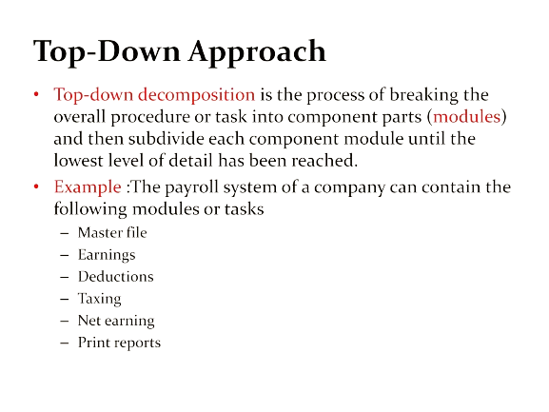
Week #7,#8
AI Academy®
7

Slide 8
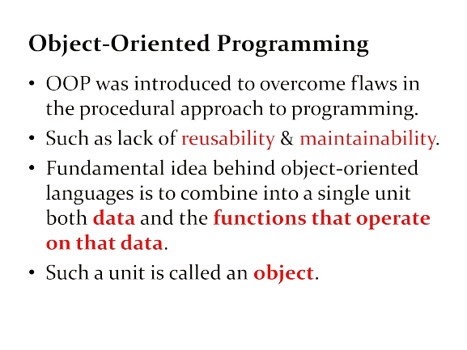
Week #7,#8
AI Academy®
8

Slide 9
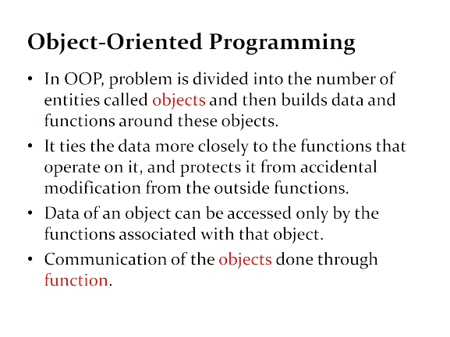
Week #7,#8
AI Academy®
9

Slide 10
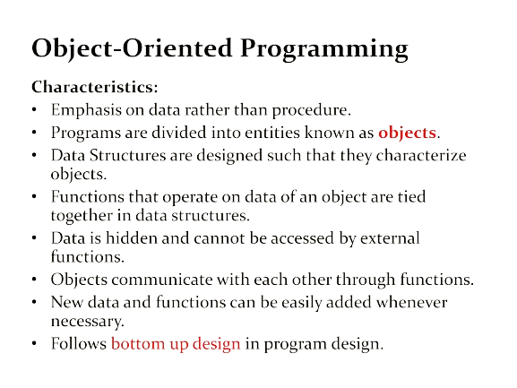
Week #7,#8
AI Academy®
10

Slide 11
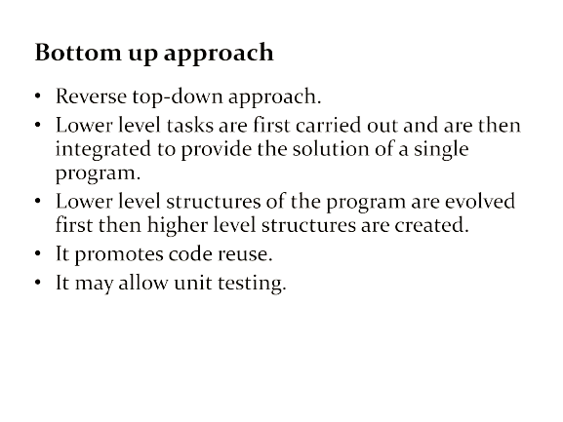
Week #7,#8
AI Academy®
11

Slide 12
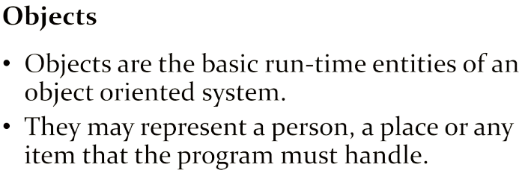

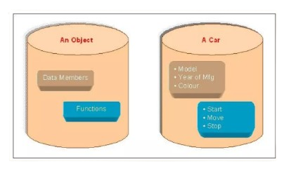
Week #7,#8
AI Academy®
12

Slide 13
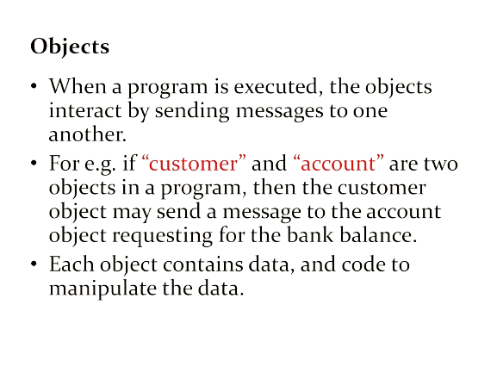
Week #7,#8
AI Academy®
1

Slide 14
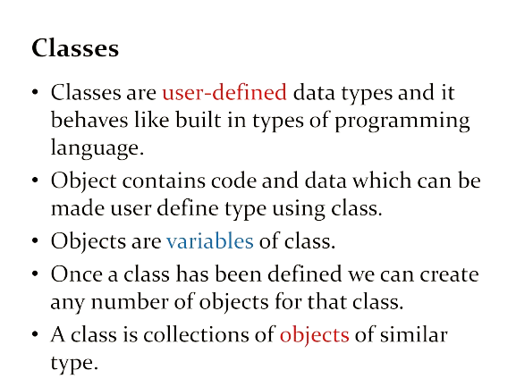
Week #7,#8
AI Academy®
14

Slide 15
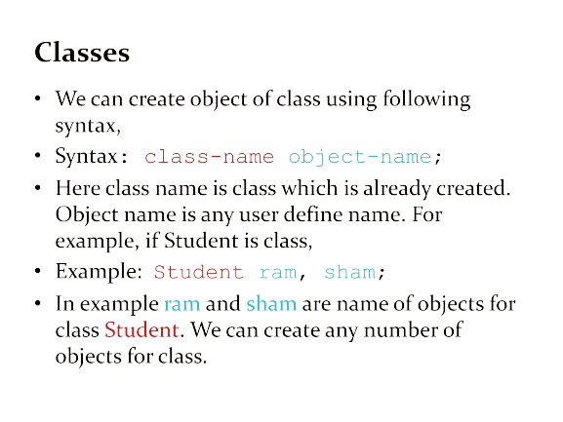
Week #7,#8
AI Academy®
15

Slide 16
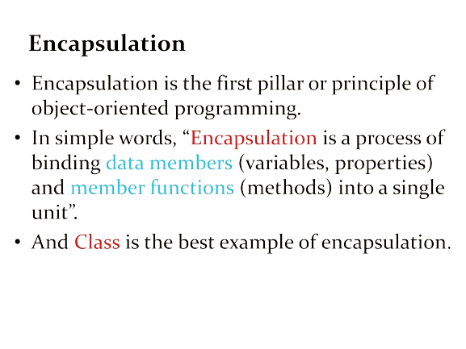
Week #7,#8
AI Academy®
16

Slide 17
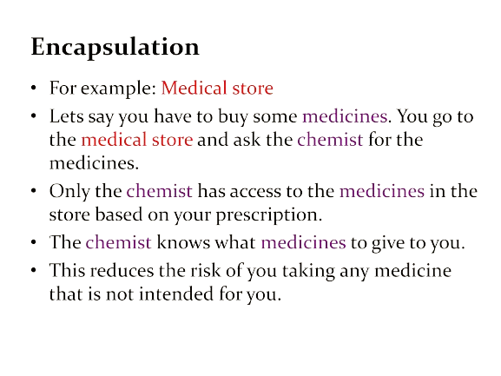
Week #7,#8
AI Academy®
17

Slide 18
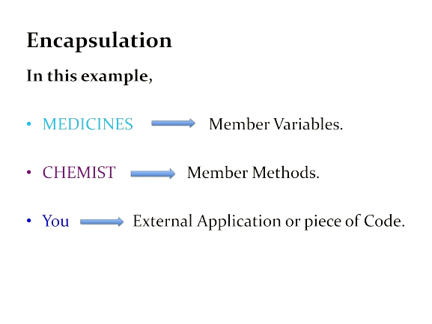
Week #7,#8
AI Academy®
18

Slide 19
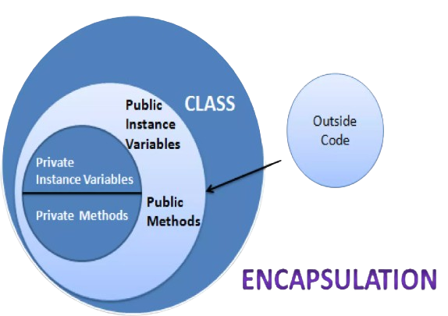
Week #7,#8
AI Academy®
19

Slide 20
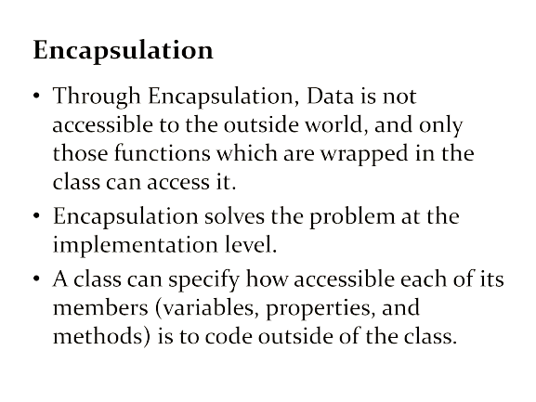
Week #7,#8
AI Academy®
20

Slide 21
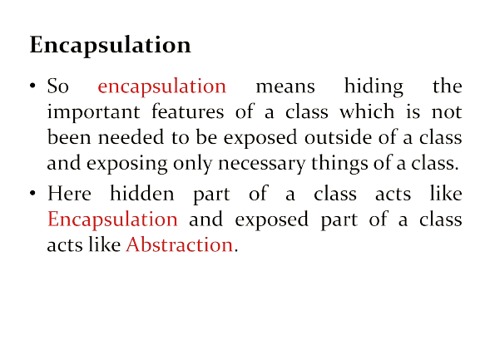
Week #7,#8
AI Academy®
21

Slide 22
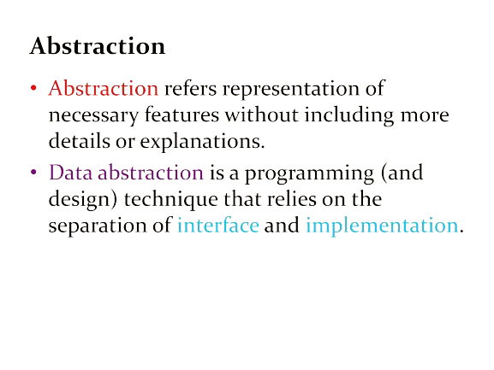
Week #7,#8
AI Academy®
22

Slide 23
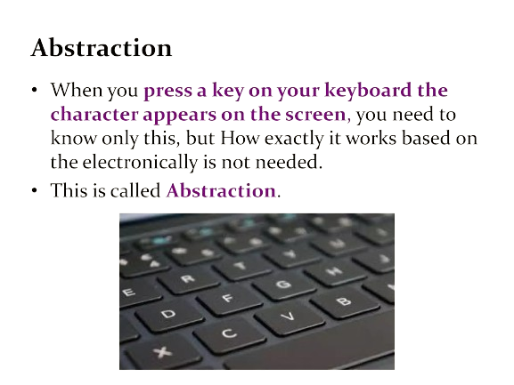
Week #7,#8
AI Academy®
23

Slide 24
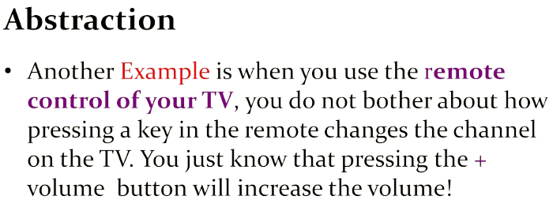

Week #7,#8
AI Academy®
24

Slide 25
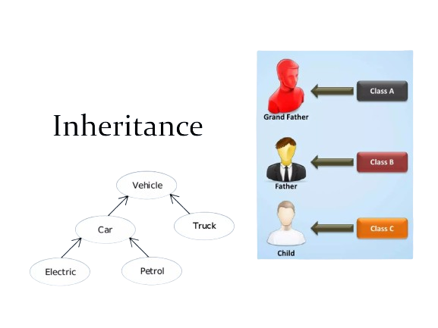
Week #7,#8
AI Academy®
25

Slide 26
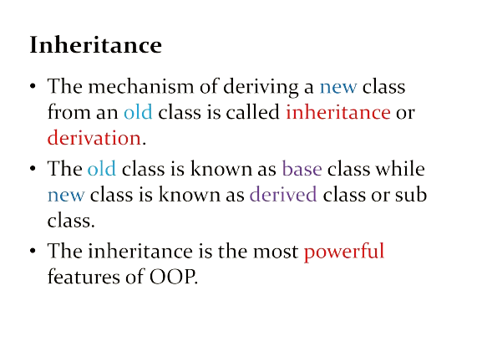
Week #7,#8
AI Academy®
26

Slide 27
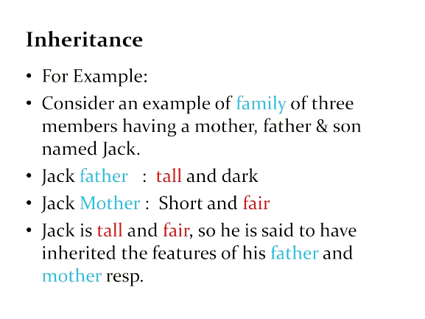
Week #7,#8
AI Academy®
27

Slide 28
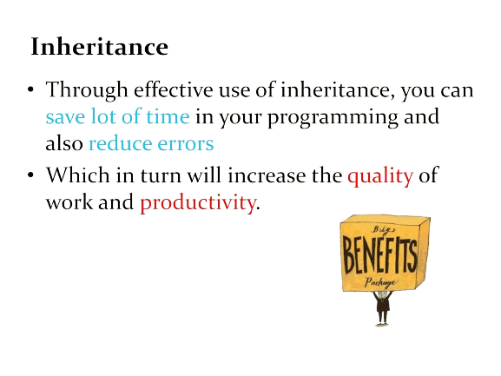
Week #7,#8
AI Academy®
28

Slide 29
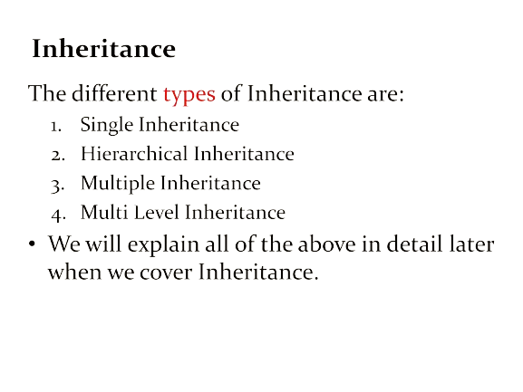
Week #7,#8
AI Academy®
29

Slide 30
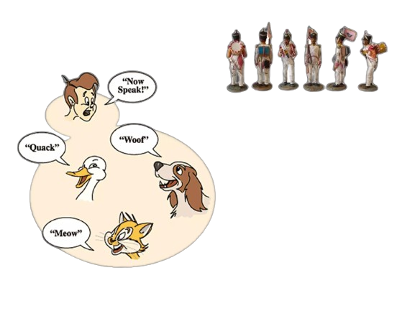

Week #7,#8
AI Academy®
30

Slide 31
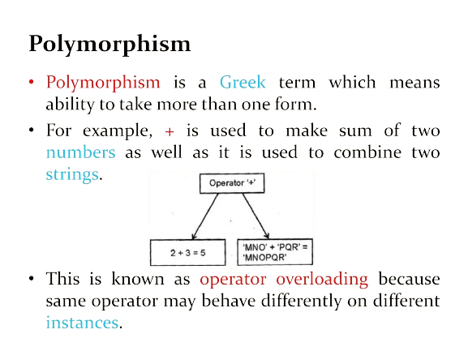
Week #7,#8
AI Academy®
31

Slide 32
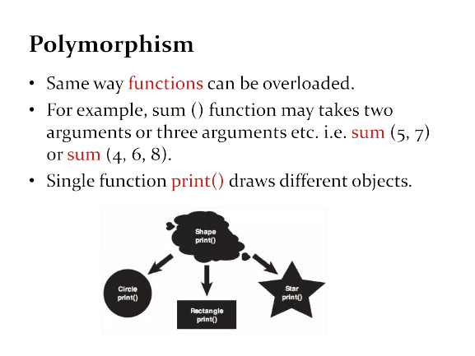
Week #7,#8
AI Academy®
32

Slide 33



Week #7,#8
AI Academy®
33

Slide 34
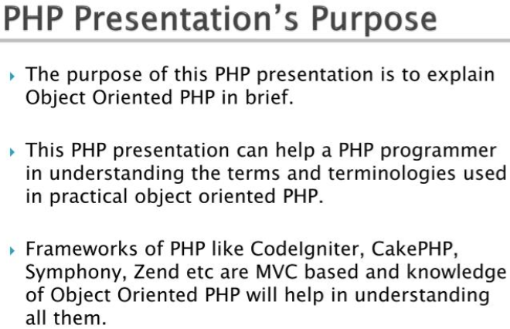
Week #7,#8
AI Academy®
34

Slide 35
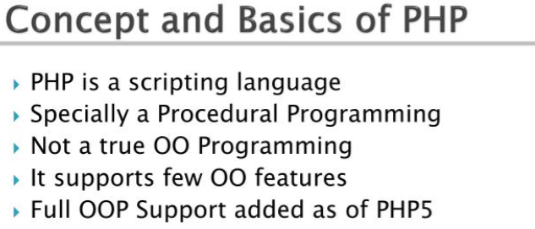
Week #7,#8
AI Academy®
35

Slide 36
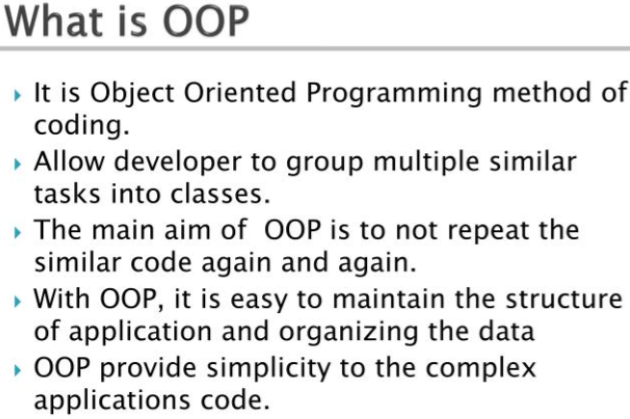
Week #7,#8
AI Academy®
36

Slide 37
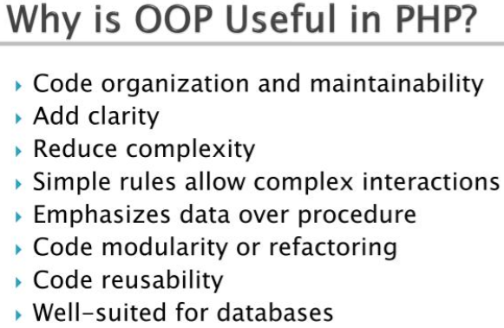
Week #7,#8
AI Academy®
37

Slide 38
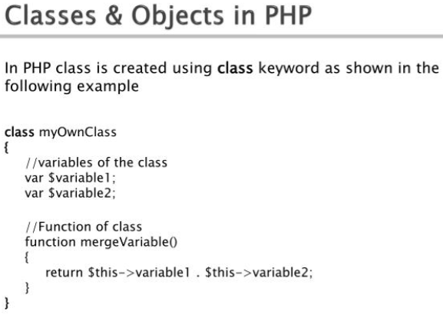
Week #7,#8
AI Academy®
38

Slide 39
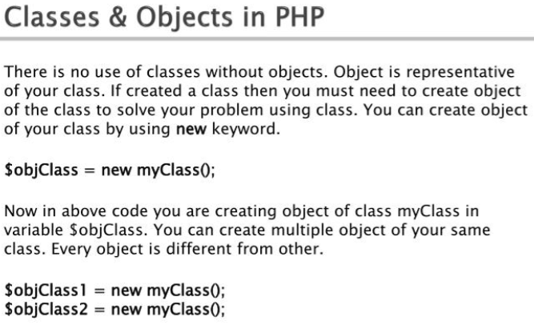
Week #7,#8
AI Academy®
39

Slide 40
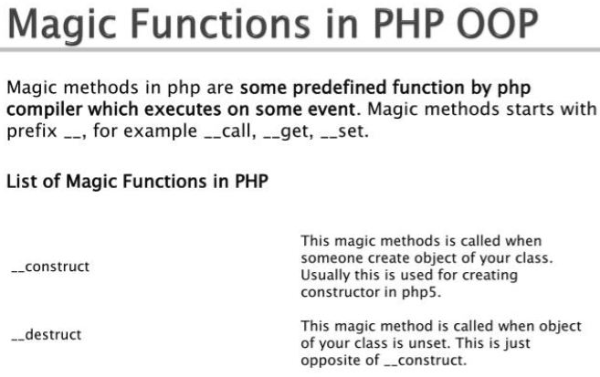
Week #7,#8
AI Academy®
40

Slide 41
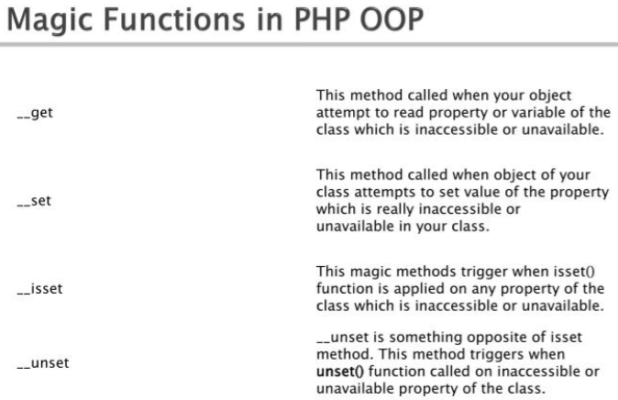
Week #7,#8
AI Academy®
41

Slide 42
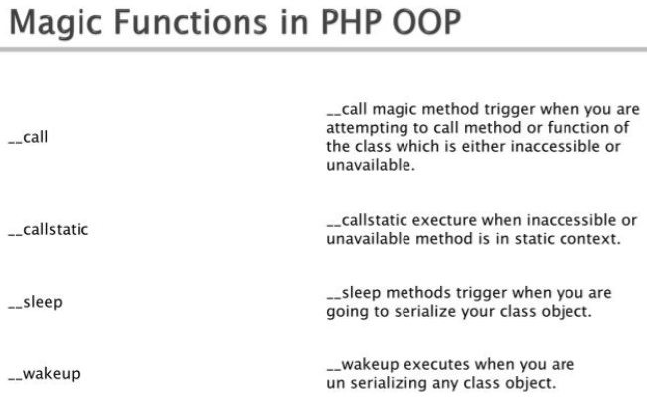
Week #7,#8
AI Academy®
42

Slide 43
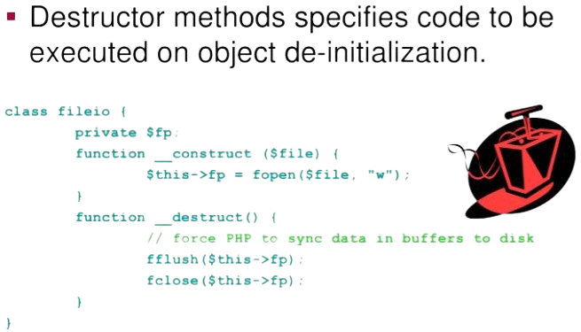
Week #7,#8
AI Academy®
43

Slide 44
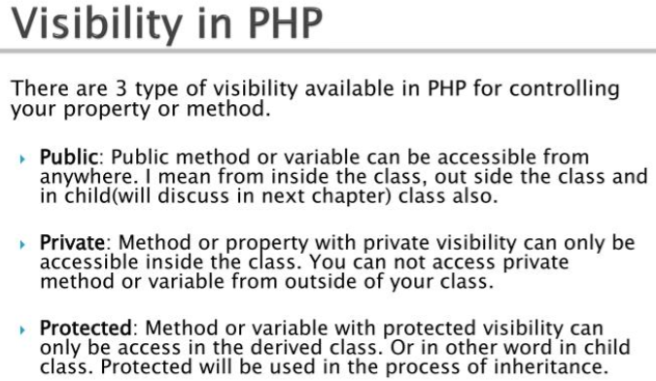
Week #7,#8
AI Academy®
44

Slide 45
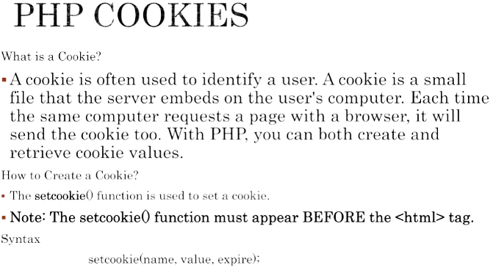
Week #7,#8
AI Academy®
45

Slide 46
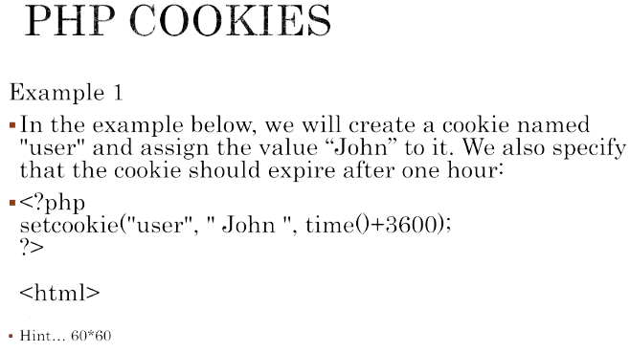
Week #7,#8
AI Academy®
46

Slide 47
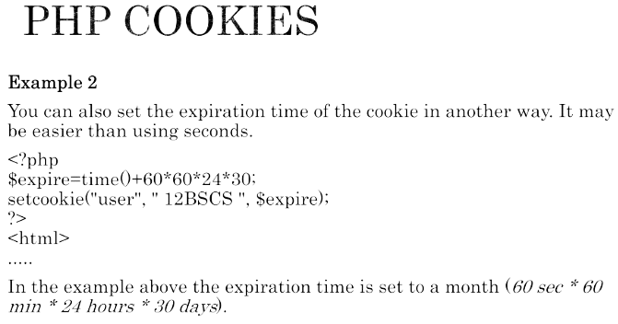
Week #7,#8
AI Academy®
47

Slide 48
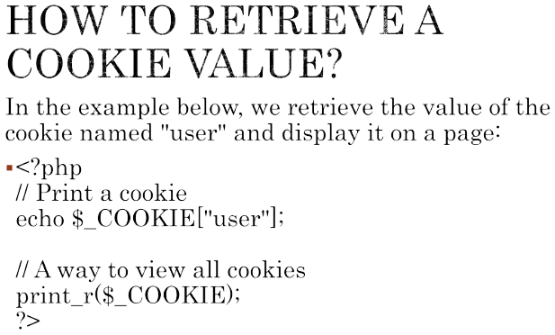
Week #7,#8
AI Academy®
48

Slide 49
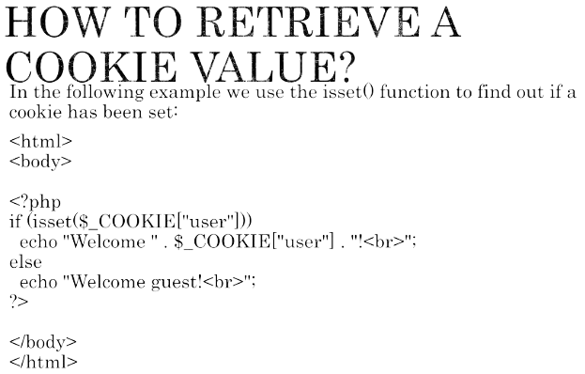
Week #7,#8
AI Academy®
49

Slide 50
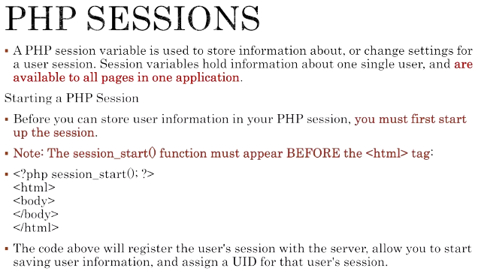
Week #7,#8
AI Academy®
50

Slide 51
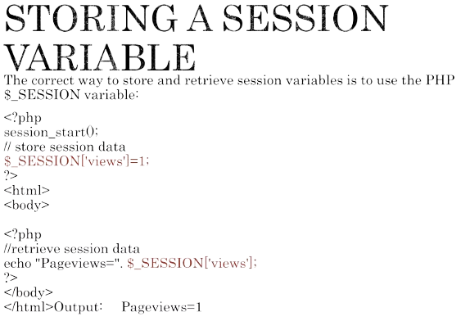
Week #7,#8
AI Academy®
51

Slide 52

Week #7,#8
AI Academy®
52

Slide 53

Week #7,#8
AI Academy®
53

Slide 54
Week #7,#8
AI Academy®
54
Day 4, 5:
MySQL Basics, Create DB, PHP My Admin
DDL, DML, DRL Operations in SQL
DB Integration with PHP
Crude Operation in MySQL
Reviews & Feedbacks

Slide 55

Week #7,#8
AI Academy®
55

Slide 56


Week #7,#8
AI Academy®
56

Slide 57


Week #7,#8
AI Academy®
57

Slide 58


Week #7,#8
AI Academy®
58

Slide 59

Week #7,#8
AI Academy®
59

Slide 60


Week #7,#8
AI Academy®
60

Slide 61


Week #7,#8
AI Academy®
61

Slide 62



Week #7,#8
AI Academy®
62

Slide 63

Week #7,#8
AI Academy®
63

Slide 64


Week #7,#8
AI Academy®
64

Slide 65


Week #7,#8
AI Academy®
65

Slide 66

Week #7,#8
AI Academy®
66

Slide 67

Week #7,#8
AI Academy®
67

Slide 68

Week #7,#8
AI Academy®
68
See the Exercise On
PHP Database Integration
GitHub @theaamirlatif

